Slide 1
gRPC, REST, Protobuf, JSON

Slide 2
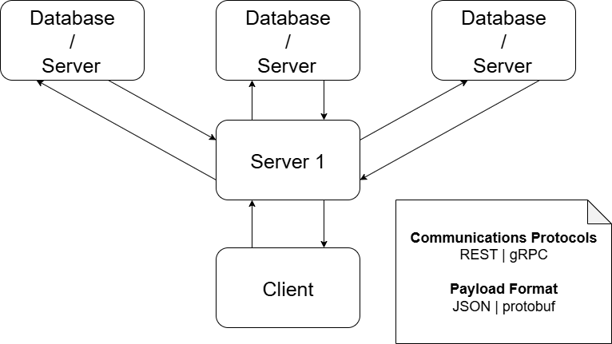
General architecture (Testing based on)

Slide 3
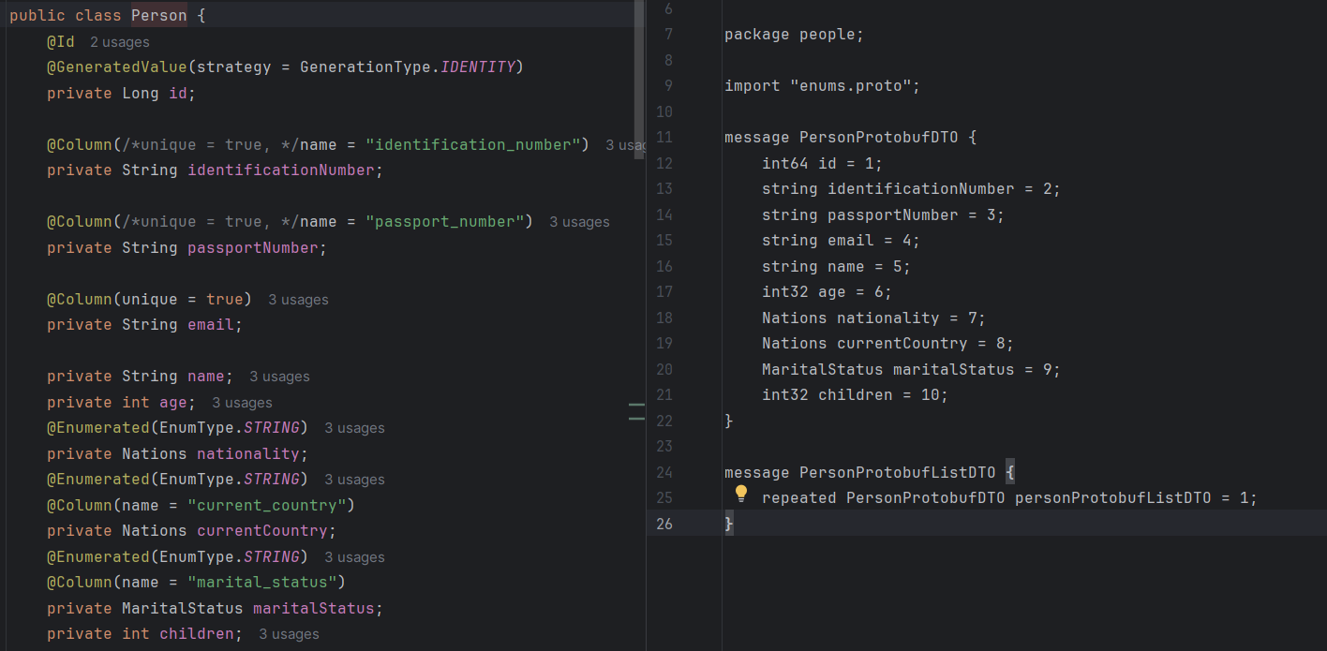
Entity / Payload [Person]
Notes:
Json protobuf, maybe due to bytes not converted, conversion not done
Grpc inconsistent not always faster?
Rest JSON still for single instances request/responses
Rest protobuf likely protocurl is not optimized

Slide 4
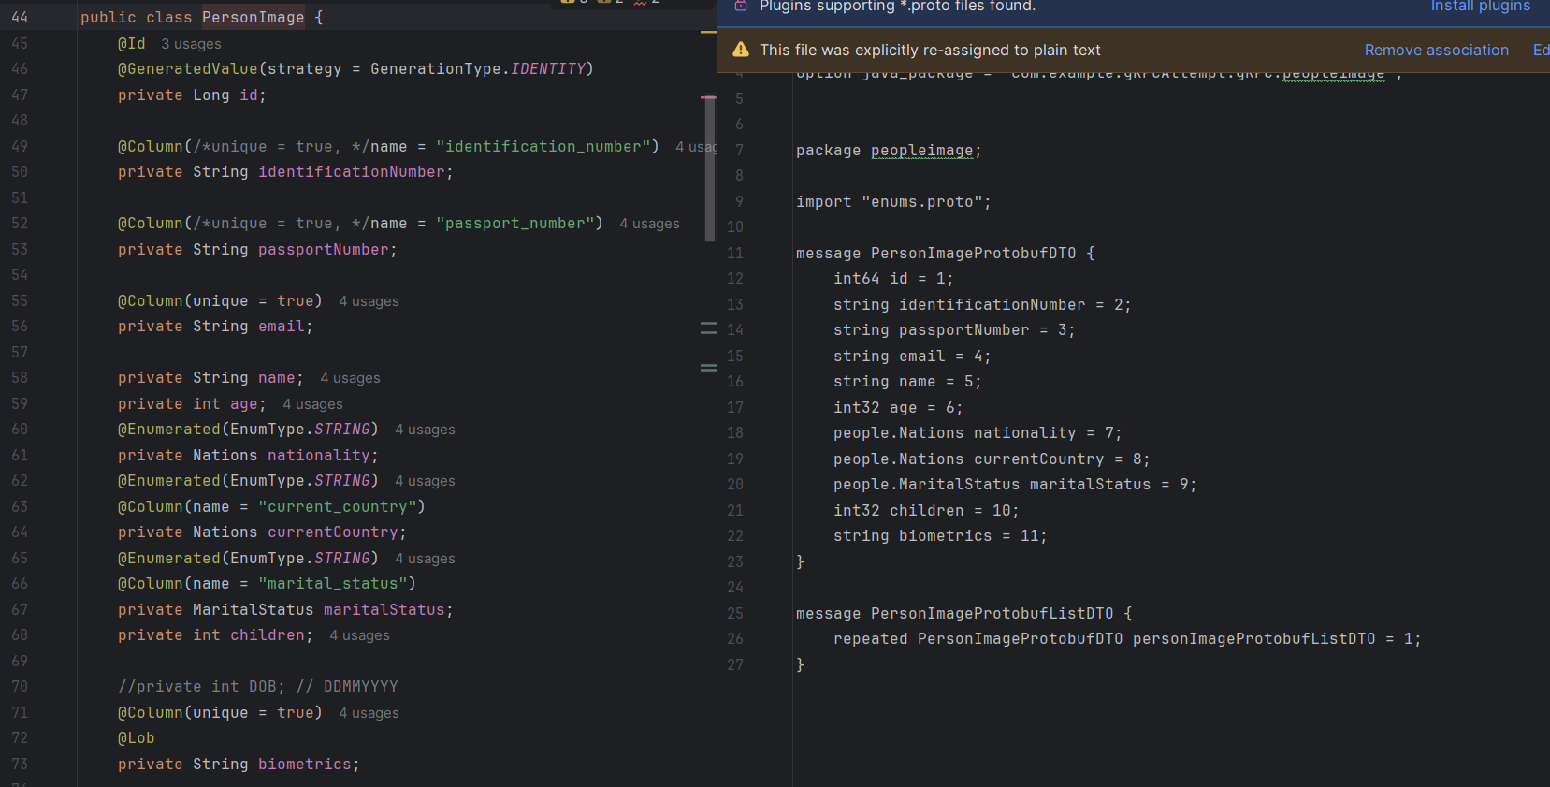
Entity / Payload [PersonImageString]
Notes:
Json protobuf, maybe due to bytes not converted, conversion not done
Grpc inconsistent not always faster?
Rest JSON still for single instances request/responses
Rest protobuf likely protocurl is not optimized

Slide 5
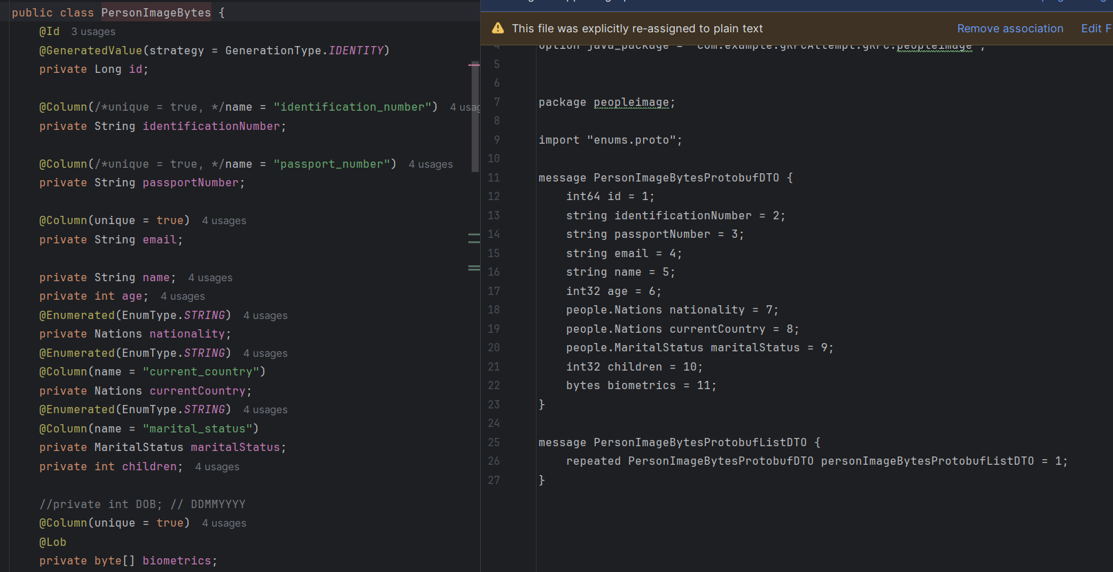
Entity / Payload [PersonImageBytes]
Notes:
Json protobuf, maybe due to bytes not converted, conversion not done
Grpc inconsistent not always faster?
Rest JSON still for single instances request/responses
Rest protobuf likely protocurl is not optimized

Slide 6
Client - Server
Note: gRPC is instanced for every call here like a REST call
Reflection for gRPC not presented in the slides

Slide 7
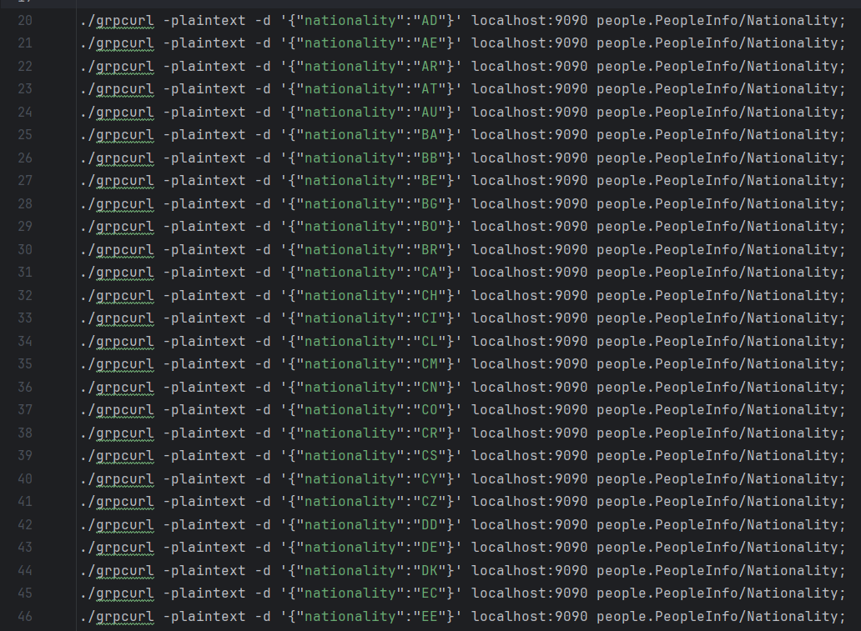
Test Case API Calls
Note: 97 Nations, 198 calls in total
Notes:
Json protobuf, maybe due to bytes not converted, conversion not done
Grpc inconsistent not always faster?
Rest JSON still for single instances request/responses
Rest protobuf likely protocurl is not optimized

Slide 8
Person payload
gRPC (gRPCurl) | REST (cURL) | REST (protoCURL) | REST (cURL) | REST (cURL)
REQUEST: protobuf RESPONSE: protobuf | REQUEST: JSON RESPONSE: protobuf | REQUEST: protobuf RESPONSE: protobuf | REQUEST: String/JSON RESPONSE: JSON | REQUEST: JSON RESPONSE: JSON
real 0m20.956s user 0m0.105s sys 0m0.749s | real 0m13.810s * user 0m0.166s sys 0m0.805s | real 0m38.767s user 0m0.121s sys 0m0.791s | real 0m22.641s user 0m0.241s sys 0m2.065s | real 0m21.812s user 0m0.166s sys 0m1.482s
*: Received protobuf is not converted into readable format, remains in protobuf binary/bytes
Notes:
Json protobuf, maybe due to bytes not converted, conversion not done
Grpc inconsistent not always faster?
Rest JSON still for single instances request/responses
Rest protobuf likely protocurl is not optimized

Slide 9
PersonImage(String) payload
gRPC (gRPCurl) | REST (cURL) | REST (protoCURL) | REST (cURL)
REQUEST: protobuf RESPONSE: protobuf | REQUEST: JSON RESPONSE: protobuf | REQUEST: protobuf RESPONSE: protobuf | REQUEST: JSON RESPONSE: JSON
real 0m22.919s user 0m0.120s sys 0m0.824s | real 0m17.600s * user 0m0.107s sys 0m0.488s | real 0m43.198s user 0m0.121s sys 0m0.928s | real 0m17.226s user 0m0.105s sys 0m0.947s
*: Received protobuf is not converted into readable format, remains in protobuf binary/bytes

Slide 10
PersonImage(Bytes) payload
PI Repository
PIB Repository
gRPC (gRPCurl) | REST (cURL) | REST (protoCURL)
REQUEST: protobuf RESPONSE: protobuf | REQUEST: JSON RESPONSE: protobuf | REQUEST: protobuf RESPONSE: protobuf
real 0m23.949s user 0m0.210s sys 0m0.948s | real 0m16.642s * user 0m0.135s sys 0m0.790s | real 0m38.019s user 0m0.229s sys 0m0.684s
gRPC (gRPCurl) | REST (cURL) | REST (protoCURL)
REQUEST: protobuf RESPONSE: protobuf | REQUEST: JSON RESPONSE: protobuf | REQUEST: protobuf RESPONSE: protobuf
real 0m23.180s user 0m0.075s sys 0m1.085s | real 0m16.290s * user 0m0.090s sys 0m0.596s | real 0m37.316s user 0m0.288s sys 0m0.902s
*: Received protobuf is not converted into readable format, remains in protobuf binary/bytes
Notes:
Protobuf binary bytes not converted

Slide 11
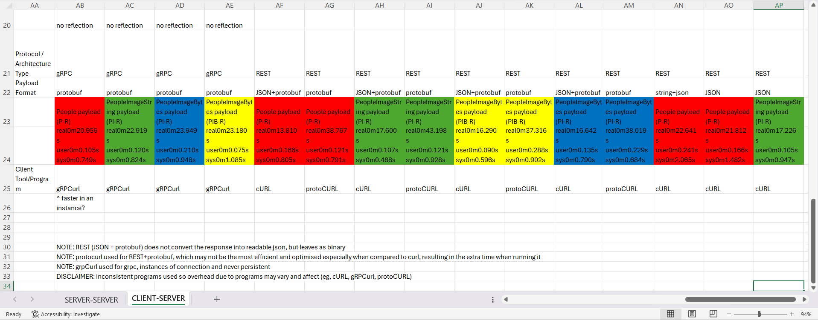
Overall View

Slide 12
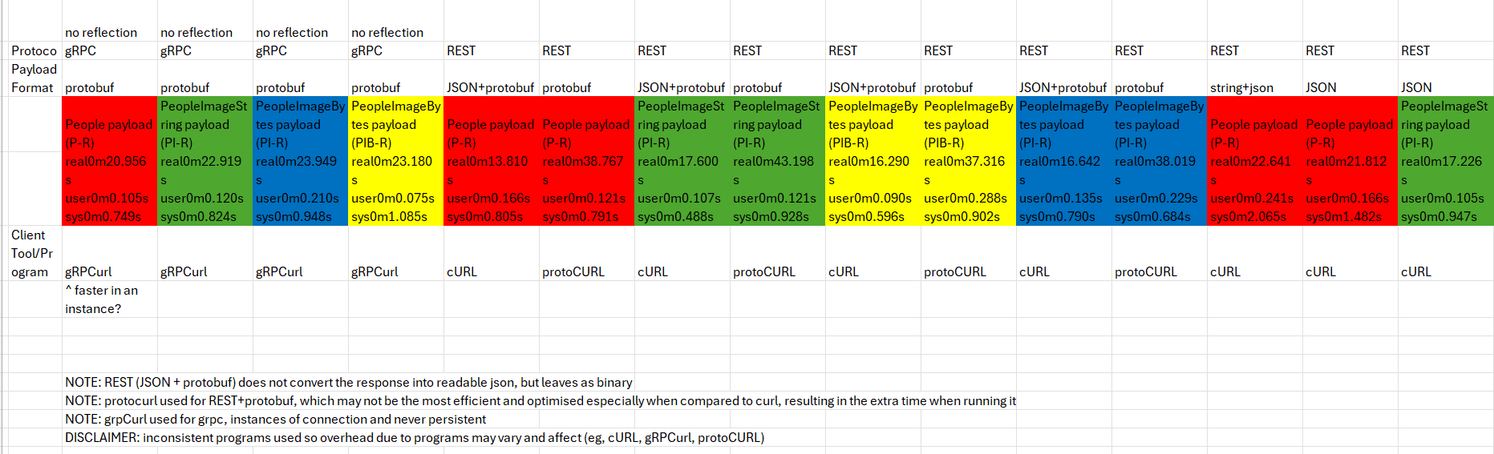
Overall View

Slide 13
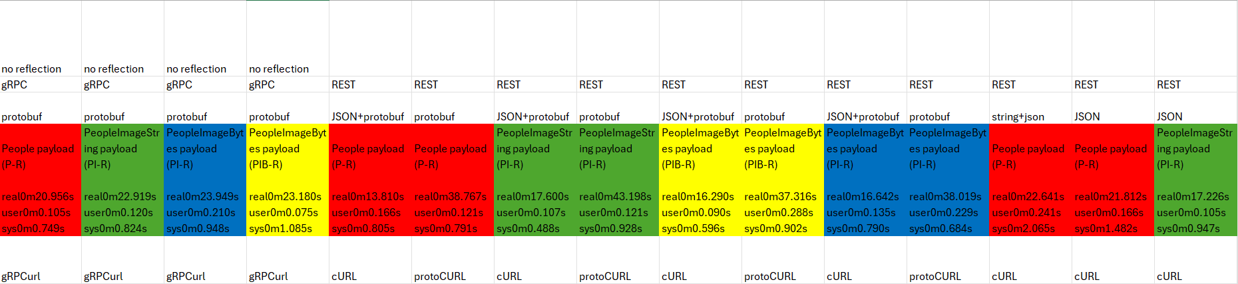
Overall View

Slide 14
Server - Server
Note: gRPC is done over a persistent connection for every call
UN-like a REST call

Slide 15
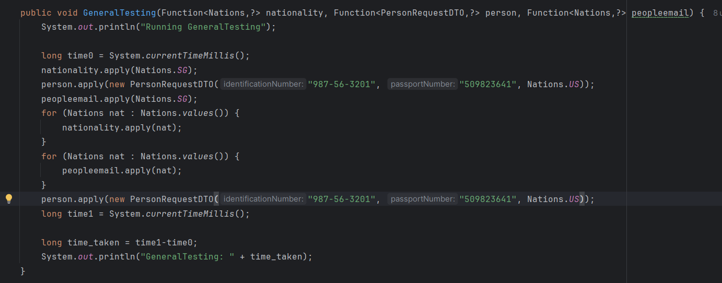
Test Case API Calls
Note: 97 Nations, 198 calls in total
Notes:
Json protobuf, maybe due to bytes not converted, conversion not done
Grpc inconsistent not always faster?
Rest JSON still for single instances request/responses
Rest protobuf likely protocurl is not optimized

Slide 16
Person payload
gRPC | REST | REST | REST | REST
REQUEST: protobuf RESPONSE: protobuf | REQUEST: JSON RESPONSE: protobuf | REQUEST: protobuf RESPONSE: protobuf | REQUEST: String/JSON RESPONSE: JSON | REQUEST: JSON RESPONSE: JSON
150.94 | 251.92 | 244.4 | 294.18 | 265.82
Average over 50 iterations, Timings are in ms(milliseconds)
Notes:
Json protobuf, maybe due to bytes not converted, conversion not done
Grpc inconsistent not always faster?
Rest JSON still for single instances request/responses
Rest protobuf likely protocurl is not optimized

Slide 17
PersonImage(String) payload
gRPC | REST | REST | REST
REQUEST: protobuf RESPONSE: protobuf | REQUEST: JSON RESPONSE: protobuf | REQUEST: protobuf RESPONSE: protobuf | REQUEST: JSON RESPONSE: JSON
1257.3 | 2243.4 | 2248.42 | 2056.3
Average over 50 iterations, Timings are in ms(milliseconds)

Slide 18
PersonImage(Bytes) payload
PI Repository
PIB Repository
gRPC | REST | REST
REQUEST: protobuf RESPONSE: protobuf | REQUEST: JSON RESPONSE: protobuf | REQUEST: protobuf RESPONSE: protobuf
1159.84 | 1575.28 | 1568.84
gRPC | REST | REST
REQUEST: protobuf RESPONSE: protobuf | REQUEST: JSON RESPONSE: protobuf | REQUEST: protobuf RESPONSE: protobuf
469.02 | 872.36 | 869.26
Average over 50 iterations, Timings are in ms(milliseconds)

Slide 19
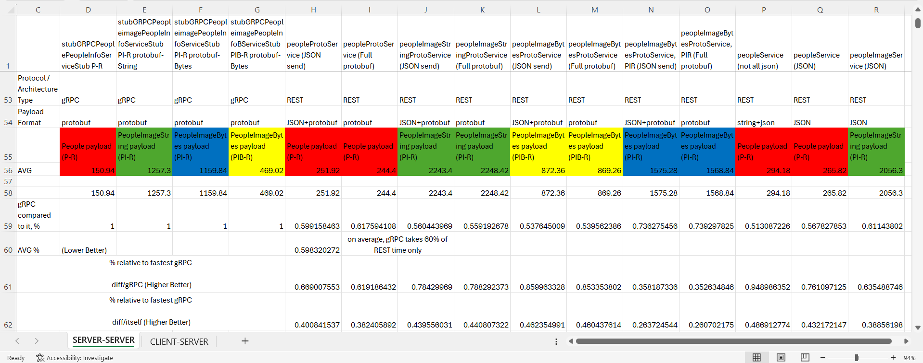
Overall View

Slide 20
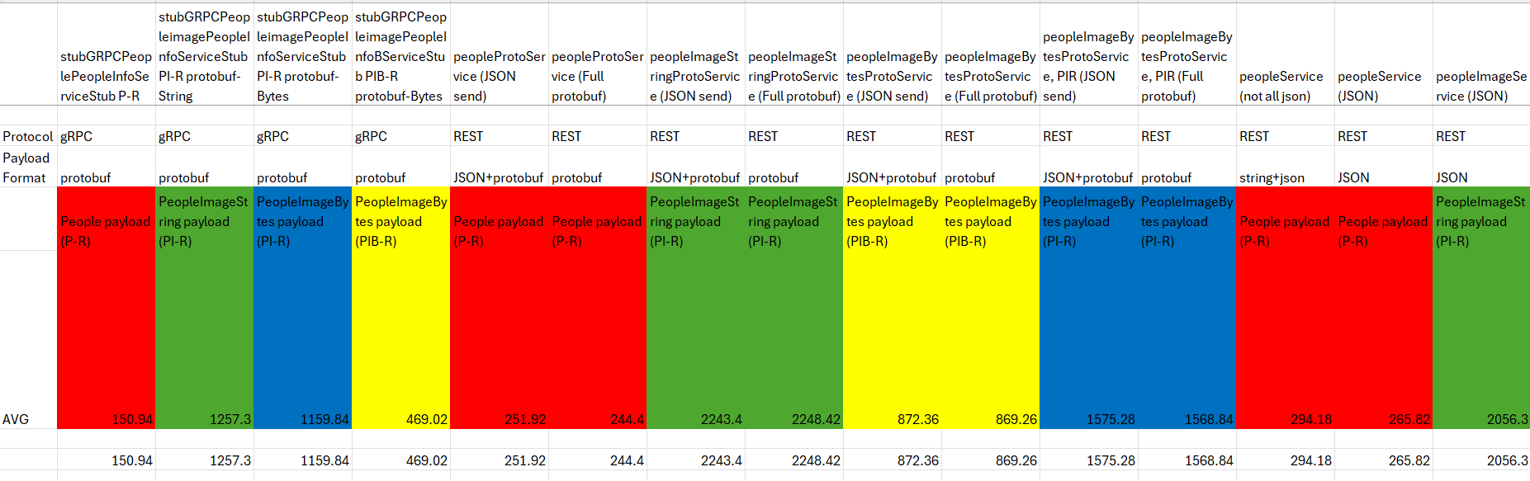
Overall View

Slide 21
Overall View

Slide 22
Server - Server (Parallel Calls)
Note: gRPC parallel calls is done over one single persistent connection for every call
UN-like a REST call

Slide 23
Person payload
gRPC | REST | REST | REST | REST
REQUEST: protobuf RESPONSE: protobuf | REQUEST: JSON RESPONSE: protobuf | REQUEST: protobuf RESPONSE: protobuf | REQUEST: String/JSON RESPONSE: JSON | REQUEST: JSON RESPONSE: JSON
30.66 | 48.28 | 50.86 | 50.02 | 50.5
Average over 50 iterations, Timings are in ms(milliseconds)
Notes:
Json protobuf, maybe due to bytes not converted, conversion not done
Grpc inconsistent not always faster?
Rest JSON still for single instances request/responses
Rest protobuf likely protocurl is not optimized

Slide 24
PersonImage(String) payload
gRPC | REST | REST | REST
REQUEST: protobuf RESPONSE: protobuf | REQUEST: JSON RESPONSE: protobuf | REQUEST: protobuf RESPONSE: protobuf | REQUEST: JSON RESPONSE: JSON
309.28 | 601.62 | 597.16 | 597.44
Average over 50 iterations, Timings are in ms(milliseconds)

Slide 25
PersonImage(Bytes) payload
PI Repository
PIB Repository
gRPC | REST | REST
REQUEST: protobuf RESPONSE: protobuf | REQUEST: JSON RESPONSE: protobuf | REQUEST: protobuf RESPONSE: protobuf
329.9 | 410.24 | 402.88
gRPC | REST | REST
REQUEST: protobuf RESPONSE: protobuf | REQUEST: JSON RESPONSE: protobuf | REQUEST: protobuf RESPONSE: protobuf
260.88 | 285.2 | 279.3
Average over 50 iterations, Timings are in ms(milliseconds)

Slide 26
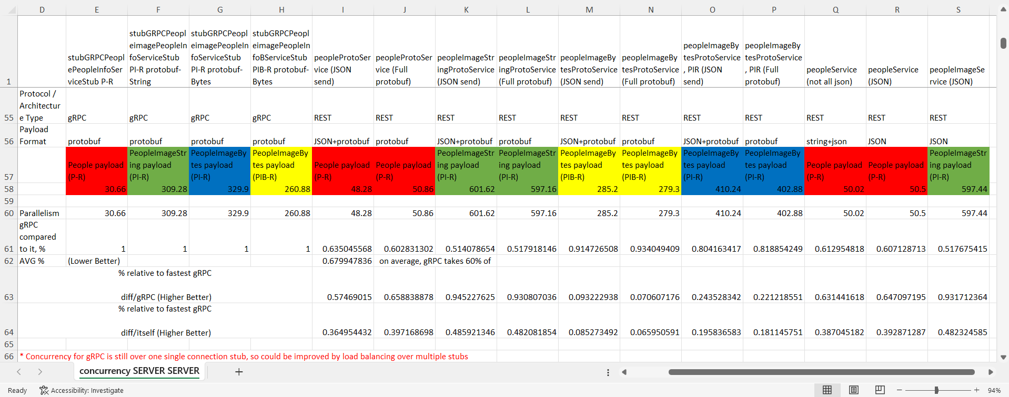
Overall View

Slide 27
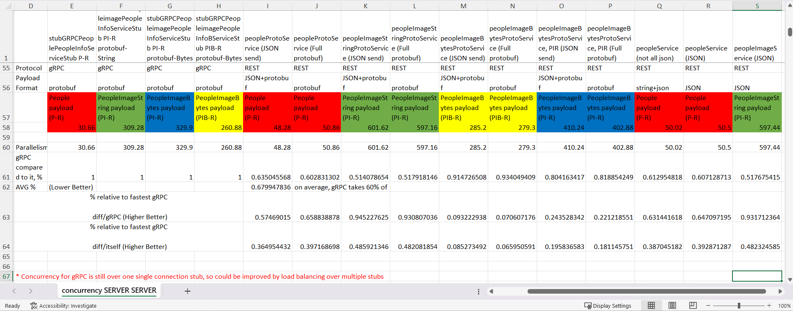
Overall View

Slide 28
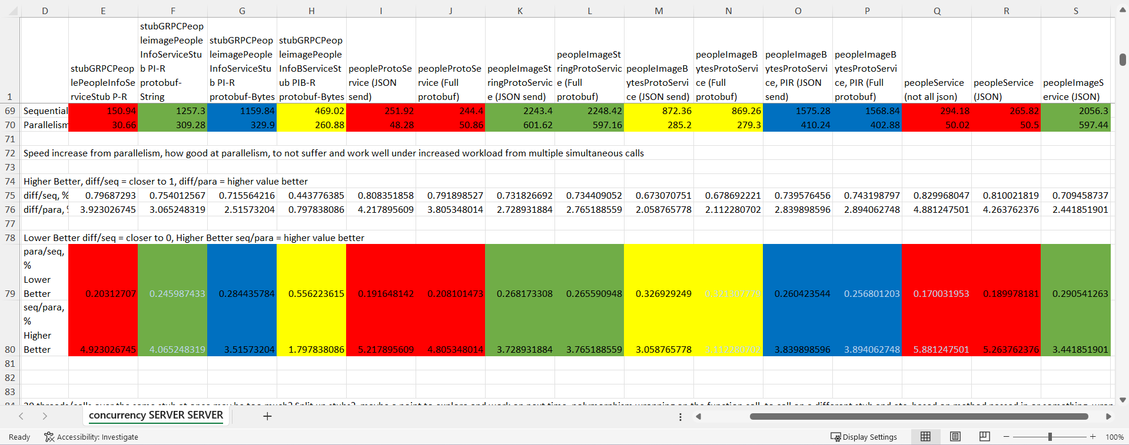
Speedup/Slowdown relative comparison
Notes:
20 threads/calls over the same stub at once may be too much? Split up stubs?, maybe a point to explore and work on next time, polymorphism wrapping on the function call, to call on a different stub and etc, based on method passed in or something, wrap in function or wrap in stub itself to load balance, in the test call or functions or stub area also can
speedup not as significant when data size is larger since from initial sequential, already lesser "free time" due to more % of it spent already so not as much "gap" time to fill up, but small payload has more gap free time, so by increasing calls, can finish much much faster
speedup not as sig also likely due to db not parallised so call and receive big data from db bottlenecked since large data already take up a lot of time so 20 calls at once will just end up being queued and bottlenecked there, not as much gap free time already prevopusly due to large payload size

